Slide 1




Training Seminars
“Renewable Energy & Energy Efficiency
as key drivers for Energy Transitions”
Part II: Energy Efficiency
Dr. Vangelis Marinakis
Electrical & Computer Engineer, NTUA, EU GCC Clean Energy Technology Network Convener
Smart Energy Technologies and Digitalization
The Network is funded by
Wednesday – March 31 – 2021

Slide 2
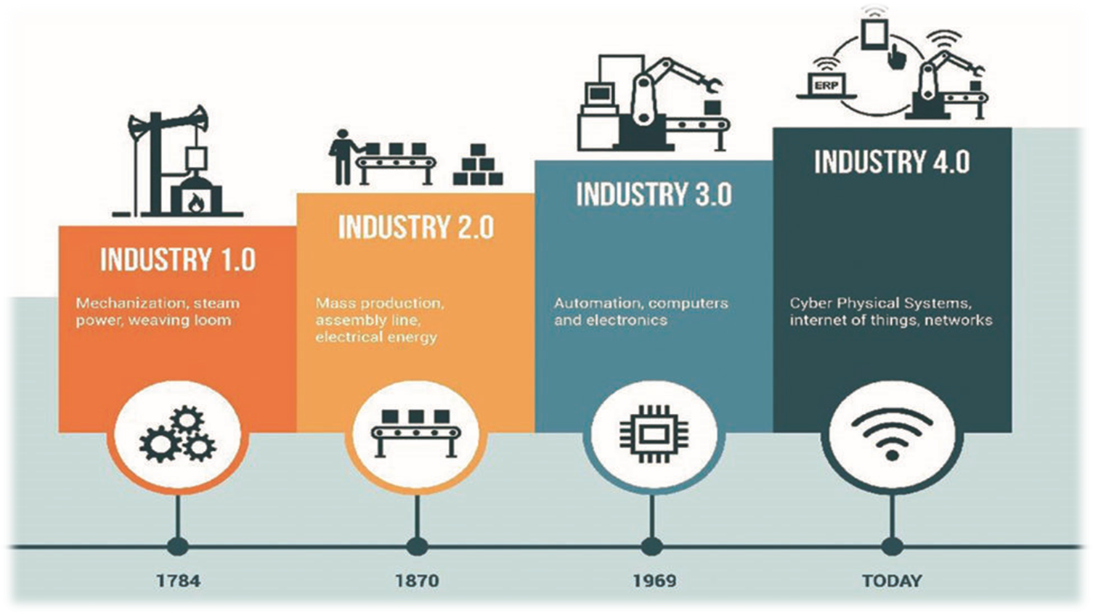
Industry 4.0
The Network is funded by

Slide 3
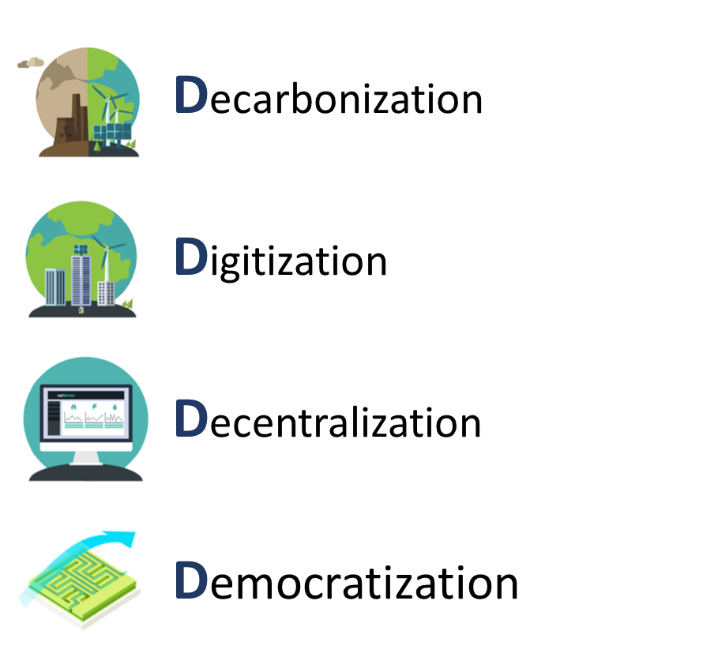
4Ds [1/6]
The 4Ds
The Network is funded by

Slide 4
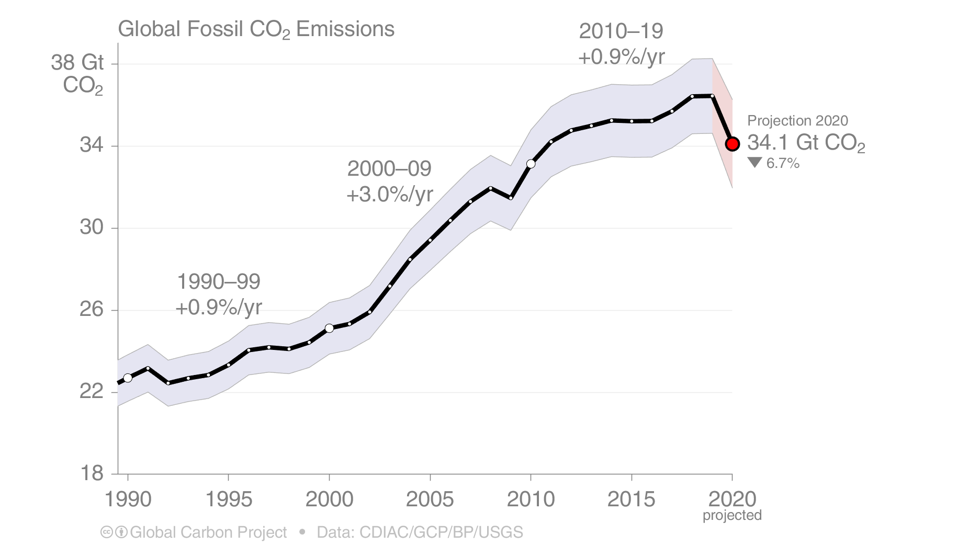
4Ds [2/6]
Decarbonization
The 2020 projection is based on preliminary data and modelling, and is the median of the four studies.
Source: CDIAC; Friedlingstein et al 2020; Global Carbon Budget 2020
The Network is funded by

Slide 5
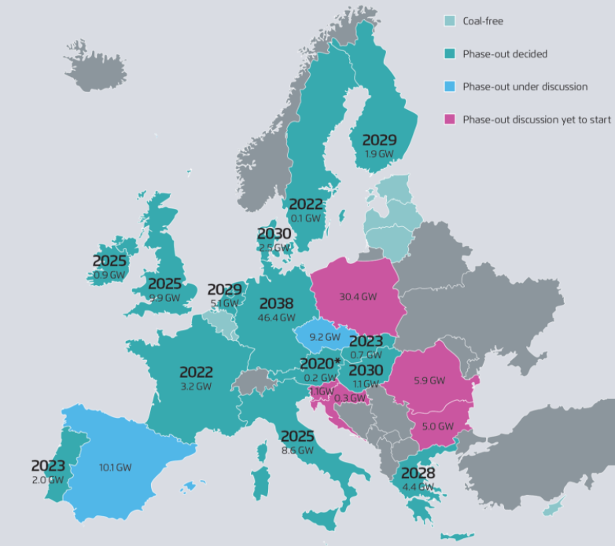
4Ds [3/6]
Decarbonization
Coal Regions in Transition
Source: The European Power Sector in 2019, European Power Sector Up-to-Date Analysis on the Electricity Transition ( March 2020), Agora Energiewende & Sandbag
The Network is funded by

Slide 6
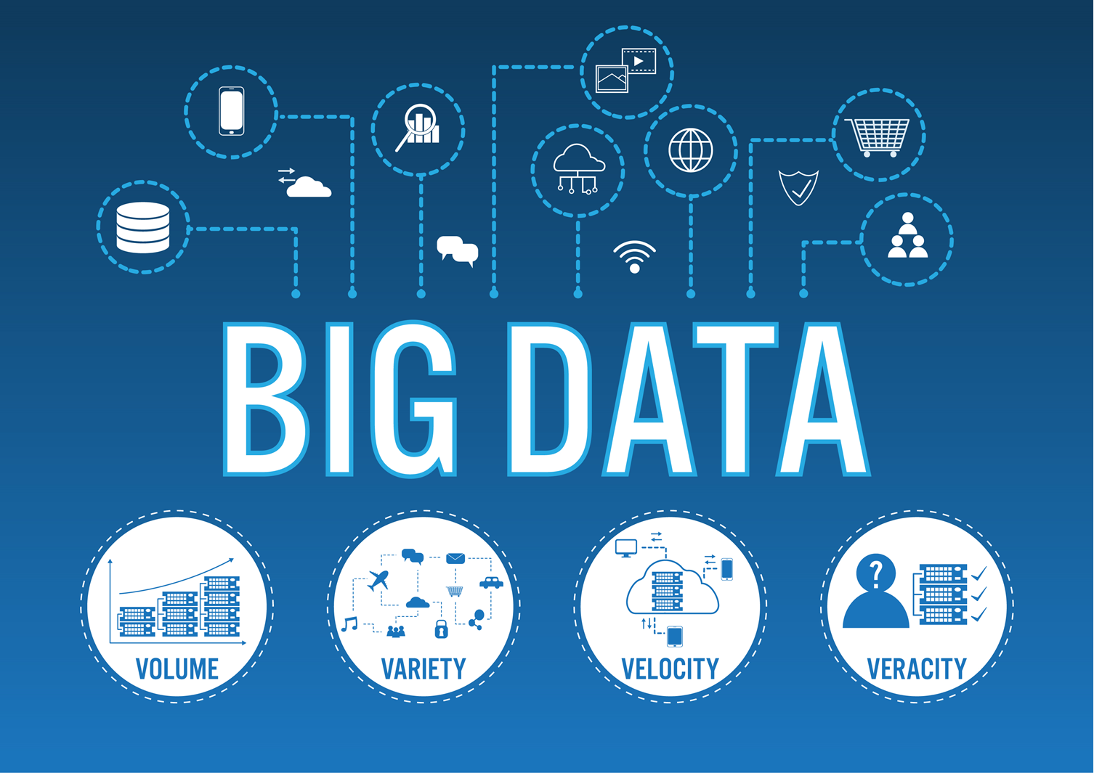
4Ds [4/6]
Digitization
Internet of Things (IoT)
Artificial Intelligence (AI)
Distributed Ledger Technology (DLT)/Blockchain
The Network is funded by

Slide 7
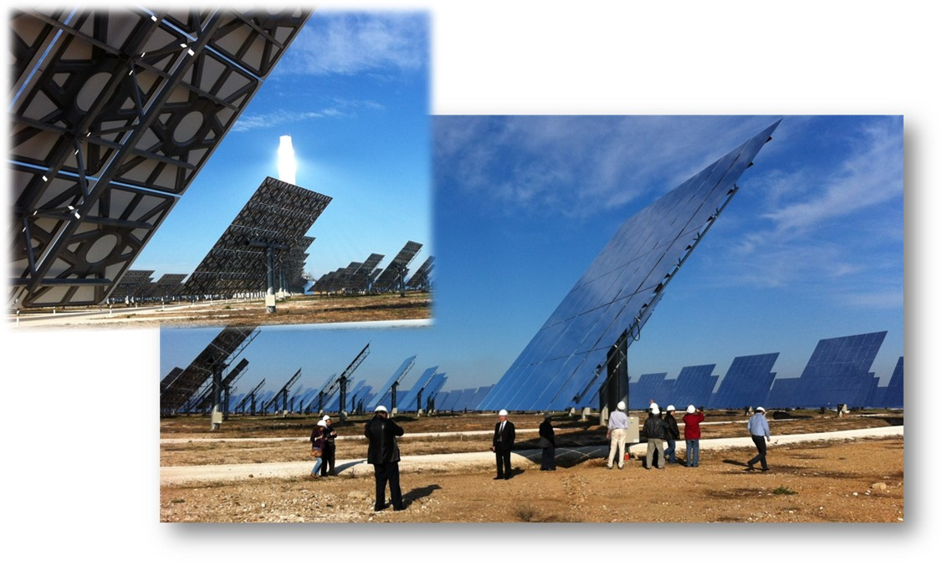
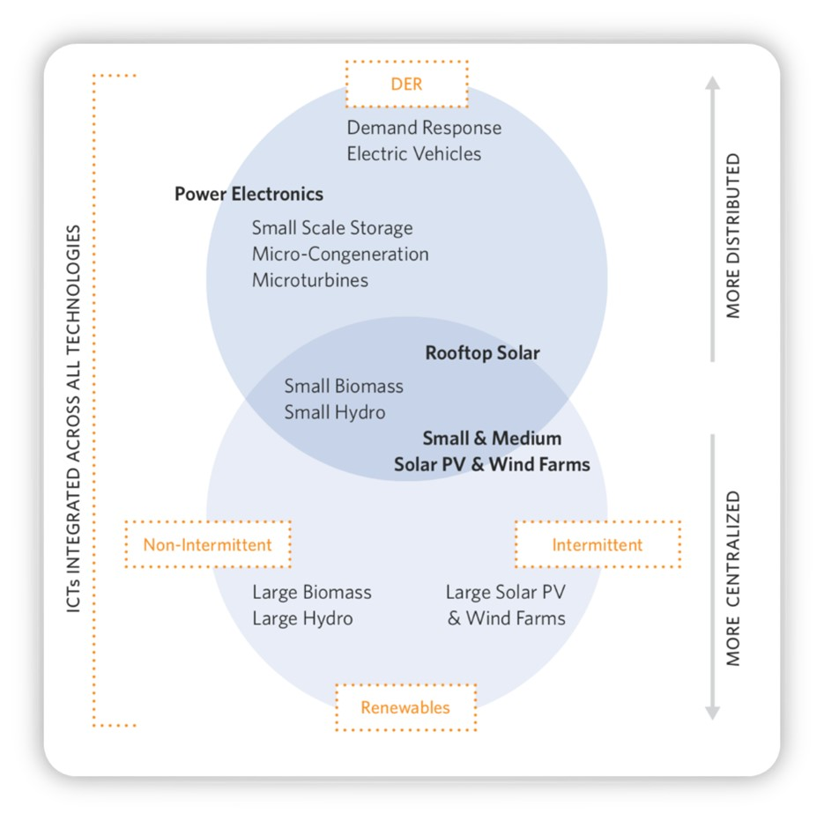
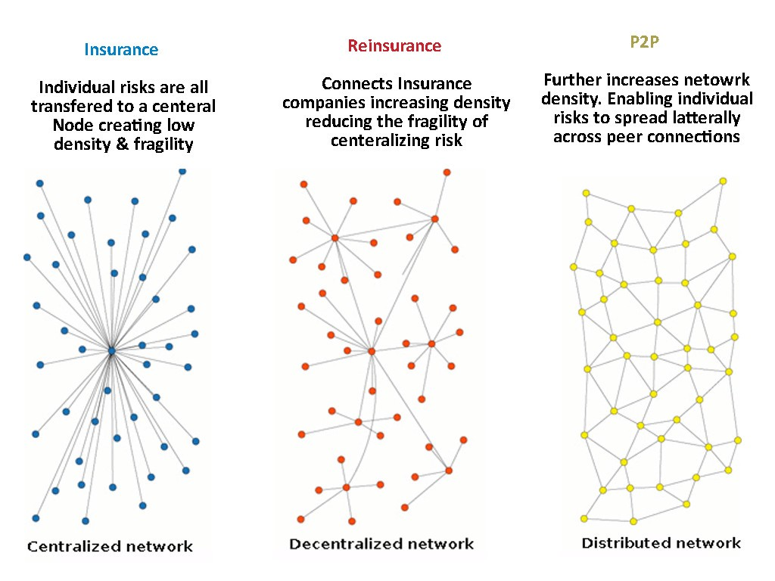
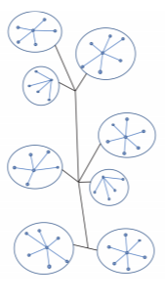
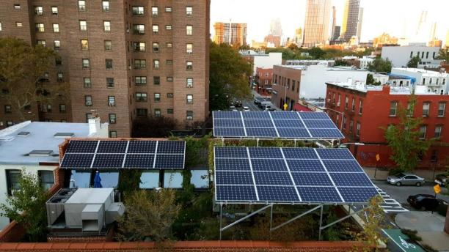
Organisation of consumer-centric electricity markets
4Ds [5/6]
Decentralization
Sharing economy
Centralized network
Decentralized network
Distributed network
Communities
The Network is funded by
The Network is funded by

Slide 8




From CONsumers to PROsumers
4Ds [6/6]
Democratization
Households
-Grid connected with on-site PV, storage systems and flexible load
-Grid connected with offsite DER
-Off grid households
Commercial Buildings
-Onsite DER and flexible load
-Corporate sourcing of RES
Industry
-Onsite DER and flexible load
-Corporate sourcing of RES
Communities
-Energy Communities
-Virtual Energy Communities
The Network is funded by

Slide 9


Data is Everywhere…
Real-time
Open Data
Historical Data
Secondary Data
Smart Meters
Weather data
BEMS
Beneficiaries
Cadastral data
Energy Market
Energy Value chain
Generators; Suppliers; TSOs; DSOs; Aggregators; Consumers, ESCOs, IFIs, Banks, Off-grid data/solution providers, etc.
Multi-scale &
Multi-stakeholder approach
EU databases
EPCs
Grid-owned assets
SECAPs actions
Energy Price
Energy Performance Contracts
The Network is funded by

Slide 10
Standardised way to collect and analyse data [1/2]
Analytics
Management
Quality
& Integration
GOVERNANCE
PROCESSING
ANALYTICS
Value
Analytics Toolbox
Collection
Data modelling
Data services
AI services
IoT
Semantic Enrichment Layer
Data Capture
Raw data
Integrated and Enriched data
Information Analysis
Decision Management
Usage Opportunities
Data Assets
Data Services
The Network is funded by

Slide 11
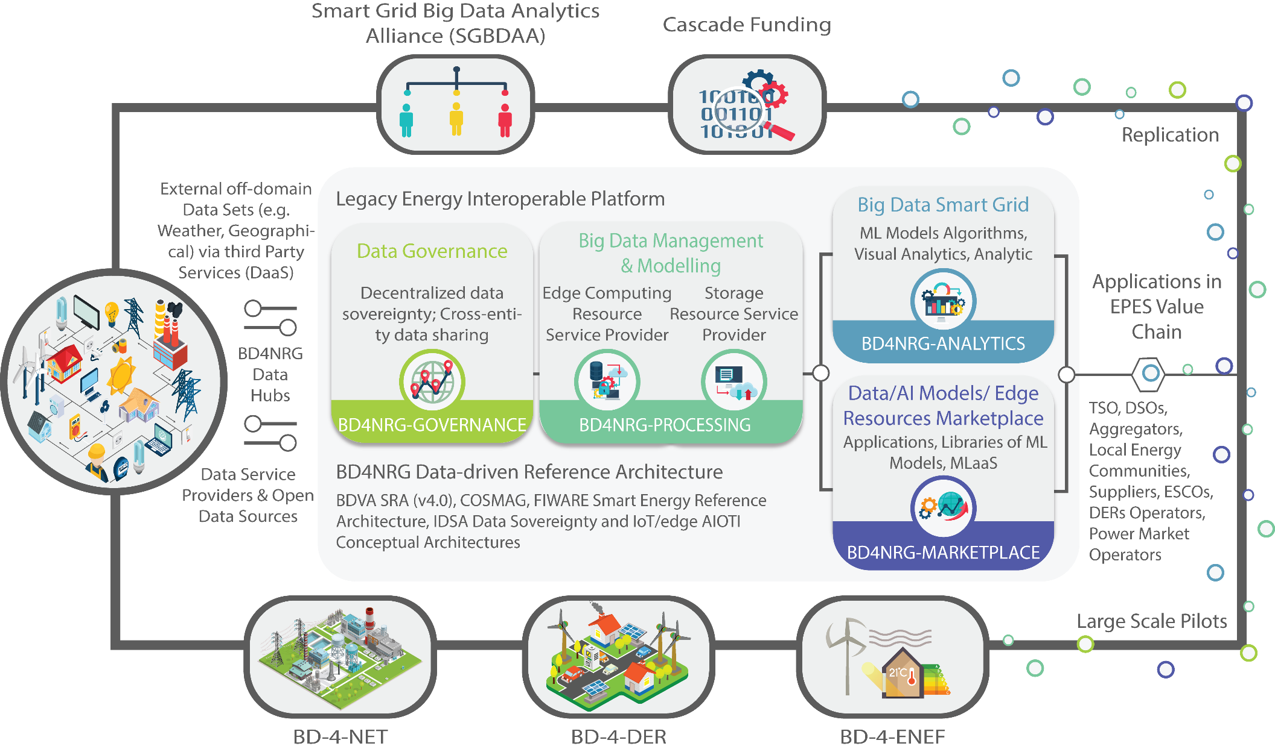
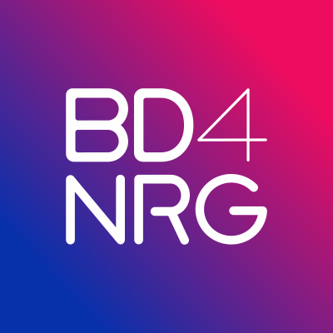
Standardised way to collect and analyse data [2/2]
Open modular Energy Analytics Toolbox
The Network is funded by

Slide 12
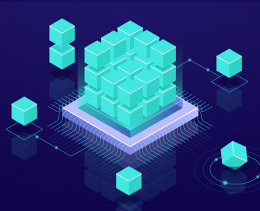
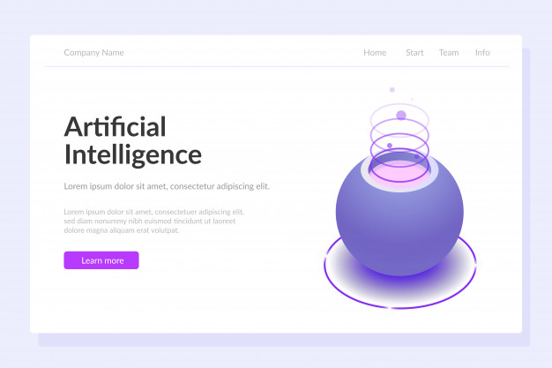


Data processing layers: From raw data to value [1/4]
Data Governance Middleware
Big Data Management & Modelling
Big Data Smart Grid Service Analytics
Data/AI Models/ Edge Resources Marketplace
Multi-party data sharing
Off-chain data sharing
FIWARE NGSI-ETSI CIM
COSMAG / GAIA-X
Connectors to Energy Actors Data-hubs
Common Information model/ SGAM (IEC based) models
Connectors IoT protocols/ SAREF, web-APIs
Elastic Data Capturing & Streaming (KAFKA)
Edge Data Stream Parallelization
Edge/IoT/Fog Resource/Service Management
Privacy-preserving federated Learning
Transfer Learning & Dynamic Self Learning
Semantic Enrichment
Polyglot Persistence
Analytic Service Builder
Models/Resources Selection Cockpit
Visual Analytics
Prescriptive Analytics
Descriptive Analytics
Predictive Analytics
Simulation Testbeds/ Hardware-in-the-Loop
Libraries of ML Models
Orchestration
Tokenization
Compliance Management
MLaaS
Innovative services through Cascade Funding
The Network is funded by

Slide 13


Data processing layers: From raw data to value [2/4]
Artificial Intelligence (AI)
Informed decision-making
  Clustering
  Correlation
  Classification
  Categorization
  Regression
  Feature extraction,
What we think it is
What it is in reality
The Network is funded by

Slide 14
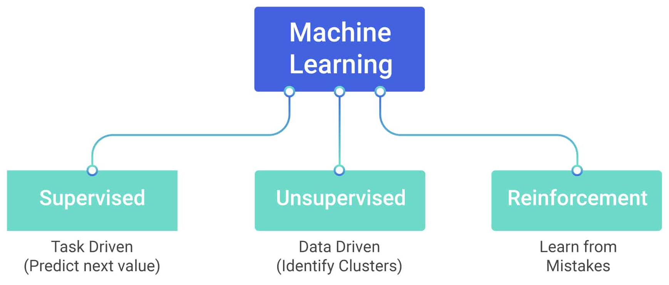
Data processing layers: From raw data to value [3/4]
Algorithms – ML
“Machine learning is the science of getting computers to act without being explicitly programmed.”
“Machine learning is based on algorithms that can learn from data without relying on rules-based programming.”
McKinsey & Co.
Stanford
The Network is funded by

Slide 15
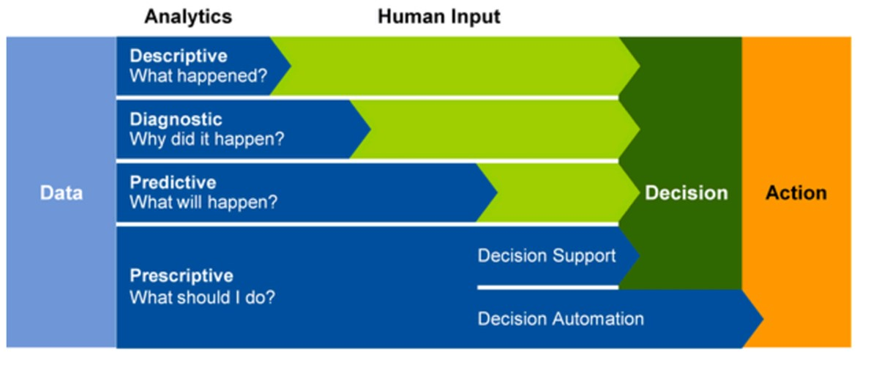
Data processing layers: From raw data to value [4/4]
Data Analytics
The Network is funded by
Source: https://adviscent.com/blog/analytics-does-your-business-need-descriptive-diagnostic-predictive-or-prescriptive-capabilities.html

Slide 16
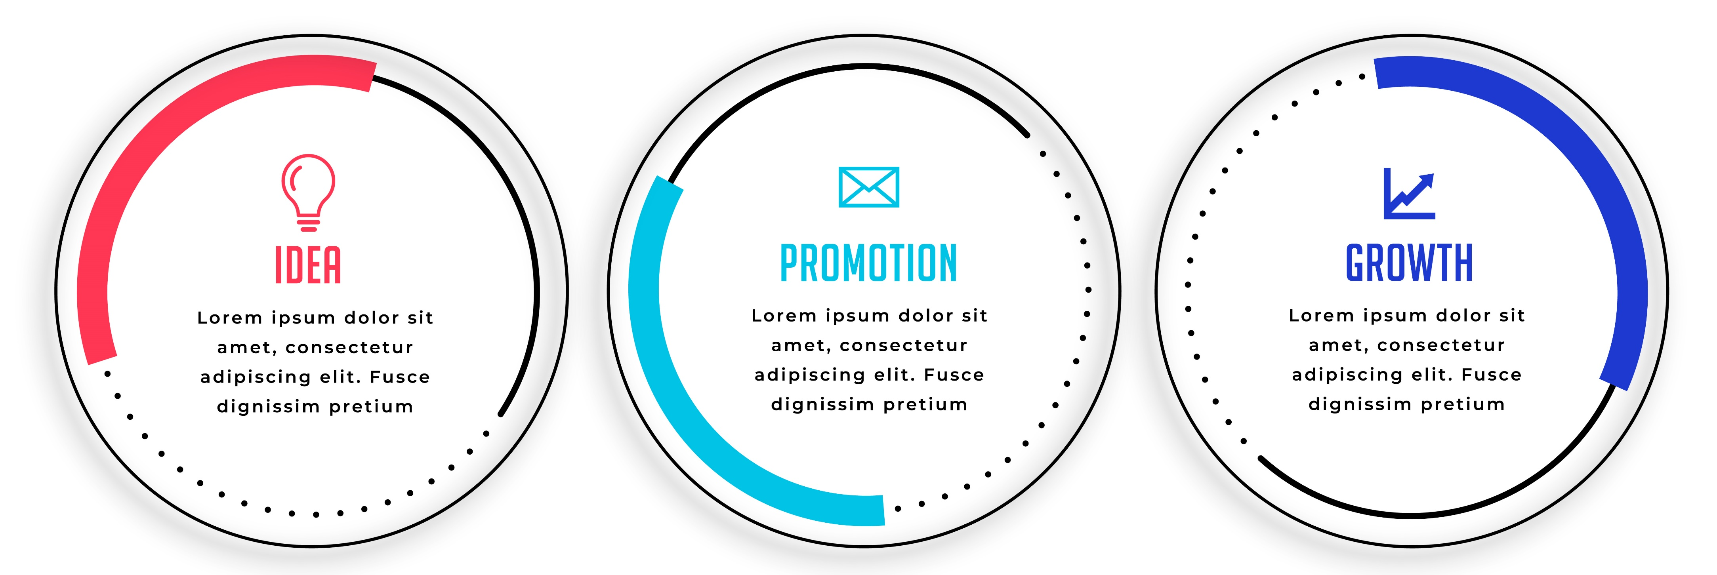
Energy analytics services [1/12]
De-risking investments in energy efficiency and increasing the efficiency and comfort of buildings​
Increased reliability of electricity network operation
Optimised management of Distributed Energy Resources​
Monitoring
The Network is funded by

Slide 17
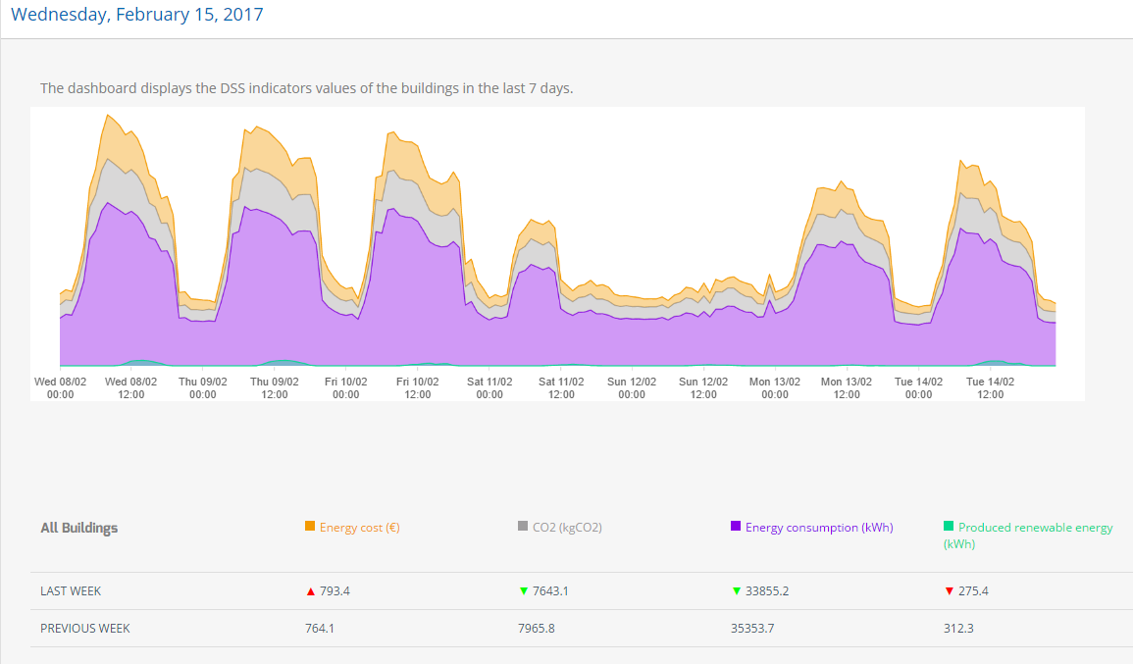
Energy analytics services [2/12]
Monitoring weekly profile
Total energy consumption
Costs
CO₂ emissions
Energy production
The Network is funded by

Slide 18
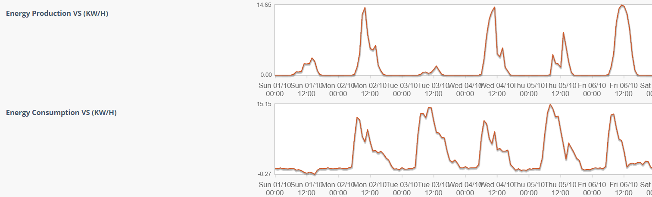
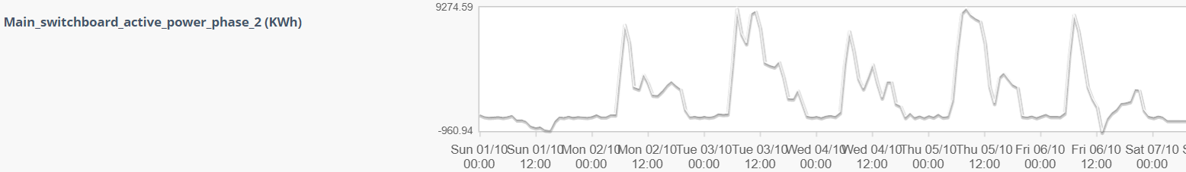
Energy analytics services [3/12]
Comparison of energy profiles of different periods
Identification of energy intensive operations and low-cost actions (quick-wins)
The Network is funded by

Slide 19
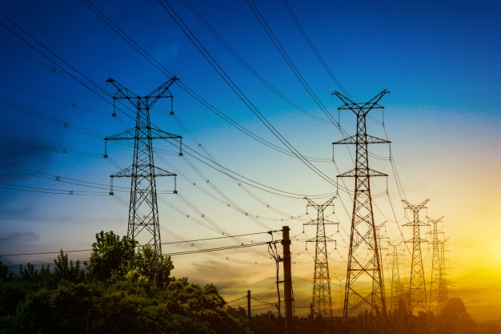
Energy analytics services [4/12]
Increased reliability of electricity network operation​
Integrating off-grid data with condition-based monitoring for enhanced predictive asset maintenance.
Cross-functional integration of grid operation with predictive asset management.
Cross-domain cross-functional integration of predictive asset management and grid operation while coordinating with EVs smart charging.
Cross-functional predictive asset management for MV grid planning.
The Network is funded by

Slide 20
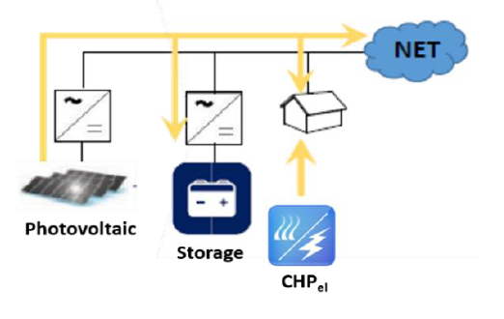
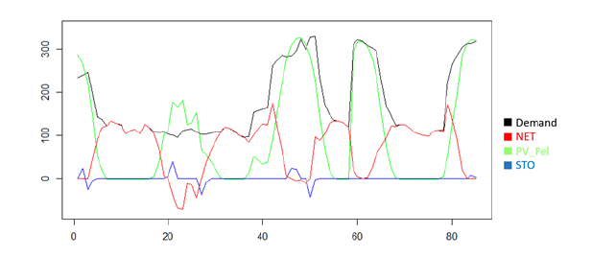
Energy analytics services [5/12]
Scheduling the operation of heating and electricity systems towards energy cost optimization
Electrical network of PV, storage, CHP and the grid
The Network is funded by

Slide 21
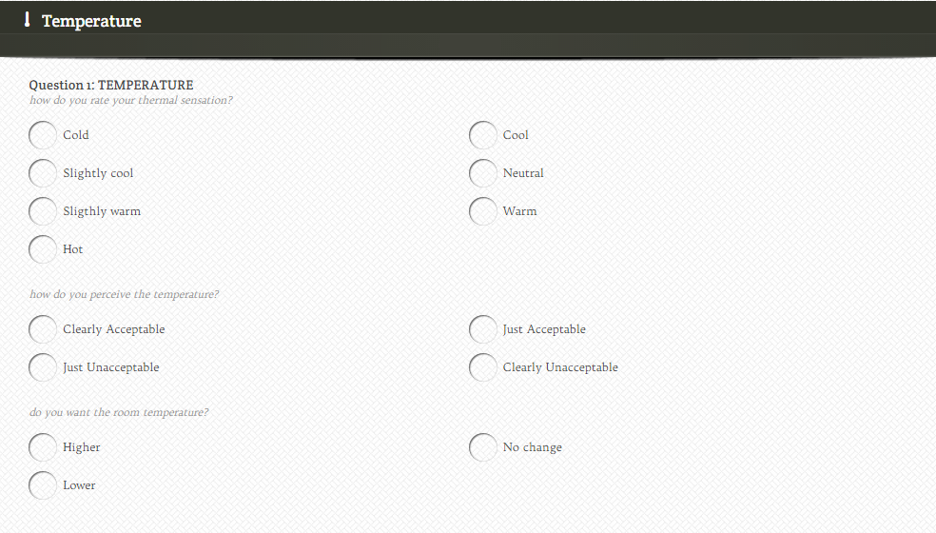





Energy analytics services [6/12]
Weather-enhanced building thermal comfort prediction
Set-point temperature management, based on the thermal sensation of the occupants
Occupants
Weather conditions
The Network is funded by

Slide 22
Energy analytics services [7/12]
Energy Performance Certificates Reliability
Support:
  (1) Harmonisation and data share of Energy Performance Certificates (EPCs).
  (2) Facilitate their compliance and checking procedures and finally
  (3) Contribute to de-risking investments in the EE sector, by analysing the refurbishment options contained in EPCs.
Assessment of the final energy consumption in the EPCs and the real consumption data from the smart meters.
Improve EPC accuracy and reliability.
The Network is funded by

Slide 23
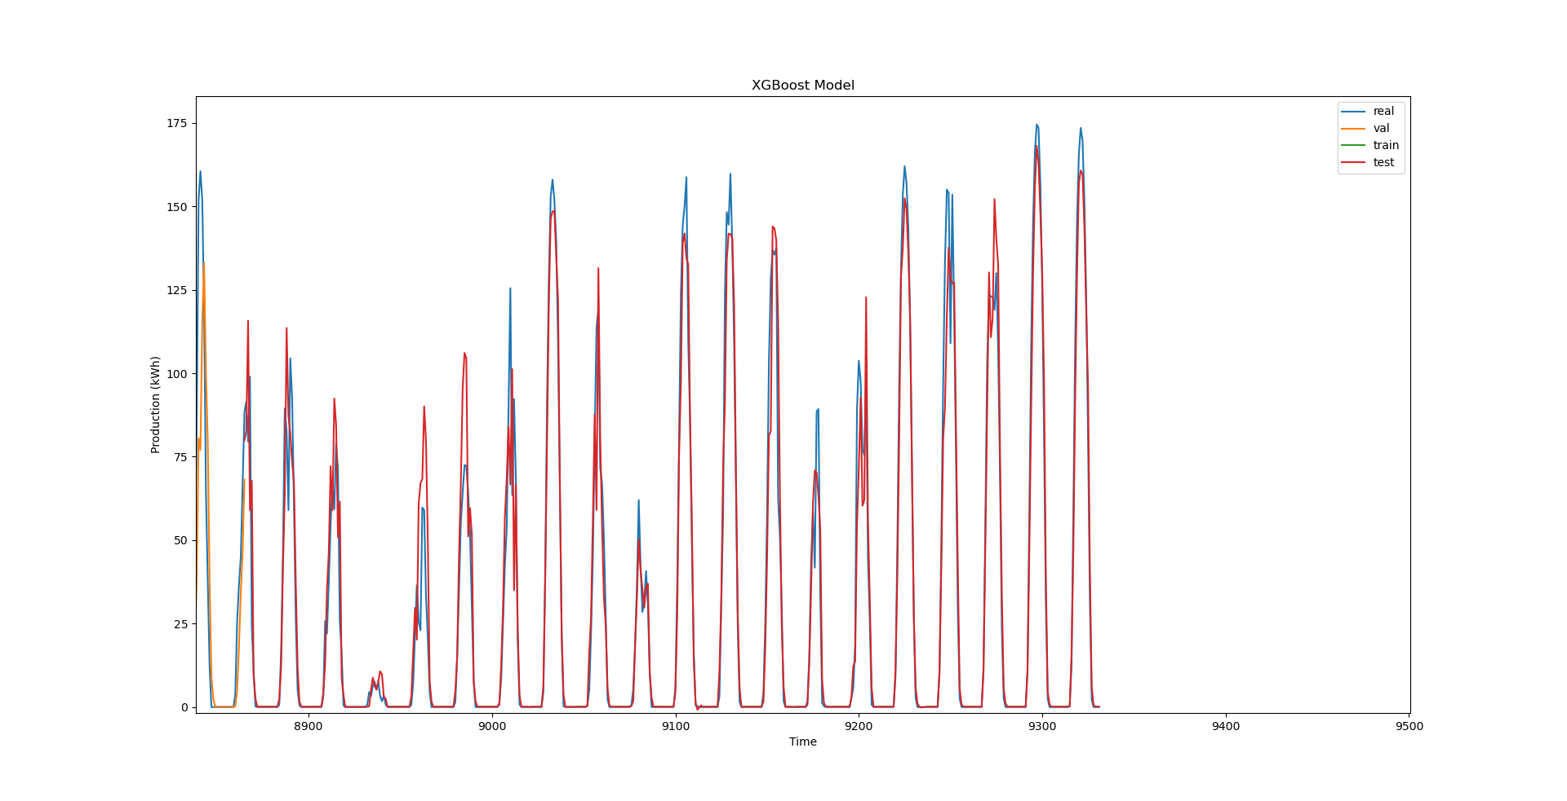
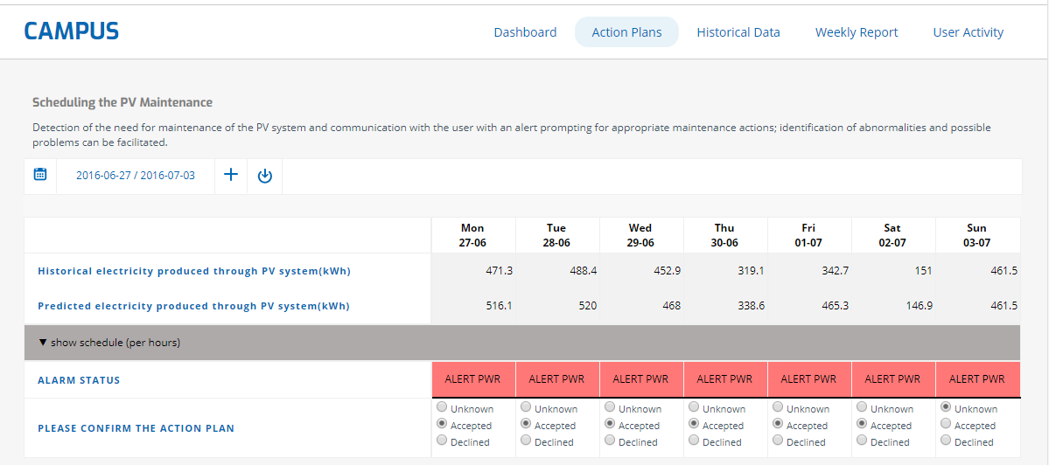
Energy analytics services [8/12]
Scheduling the PV maintenance
Models: LSTM, XGBoost, Random Forest Regression
The Network is funded by

Slide 24
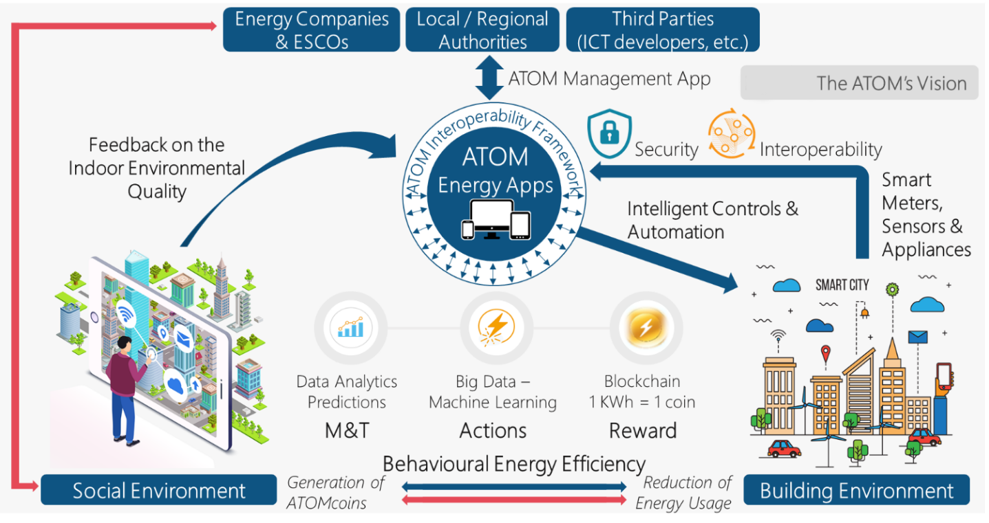
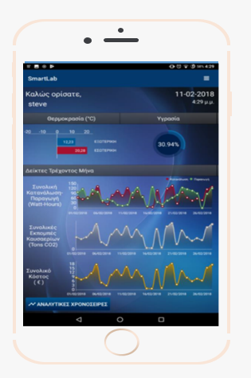

Energy analytics services [9/12]
Behavioural Energy Efficiency
The Network is funded by

Slide 25
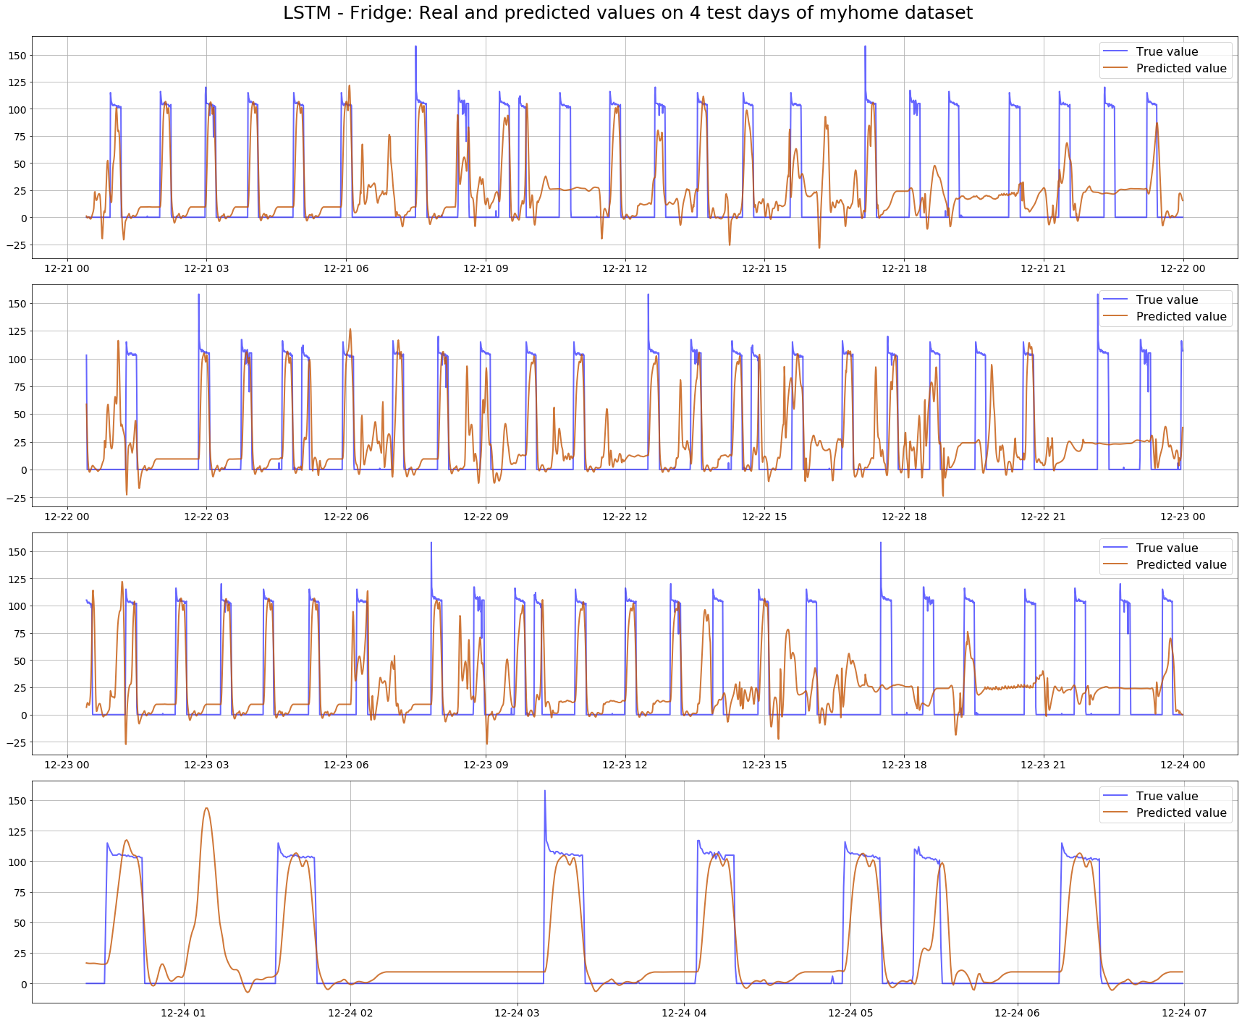
Energy analytics services [10/12]
Energy Disaggregation
  Separating an aggregate energy signal into the consumption of individual appliances in a household
The Network is funded by

Slide 26
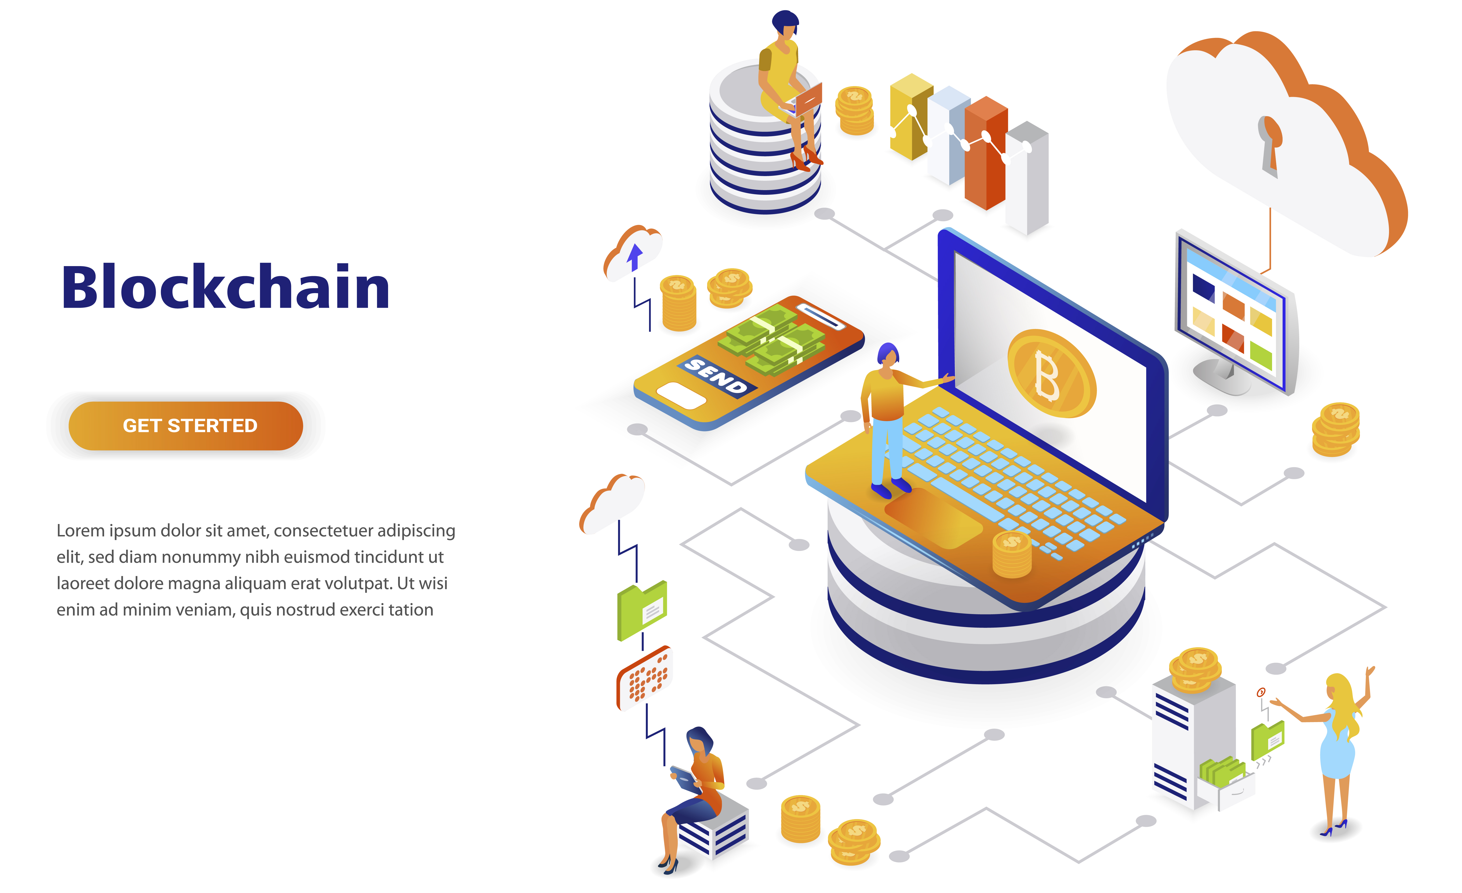
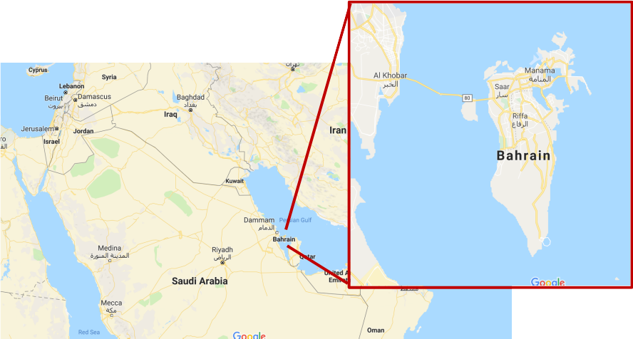


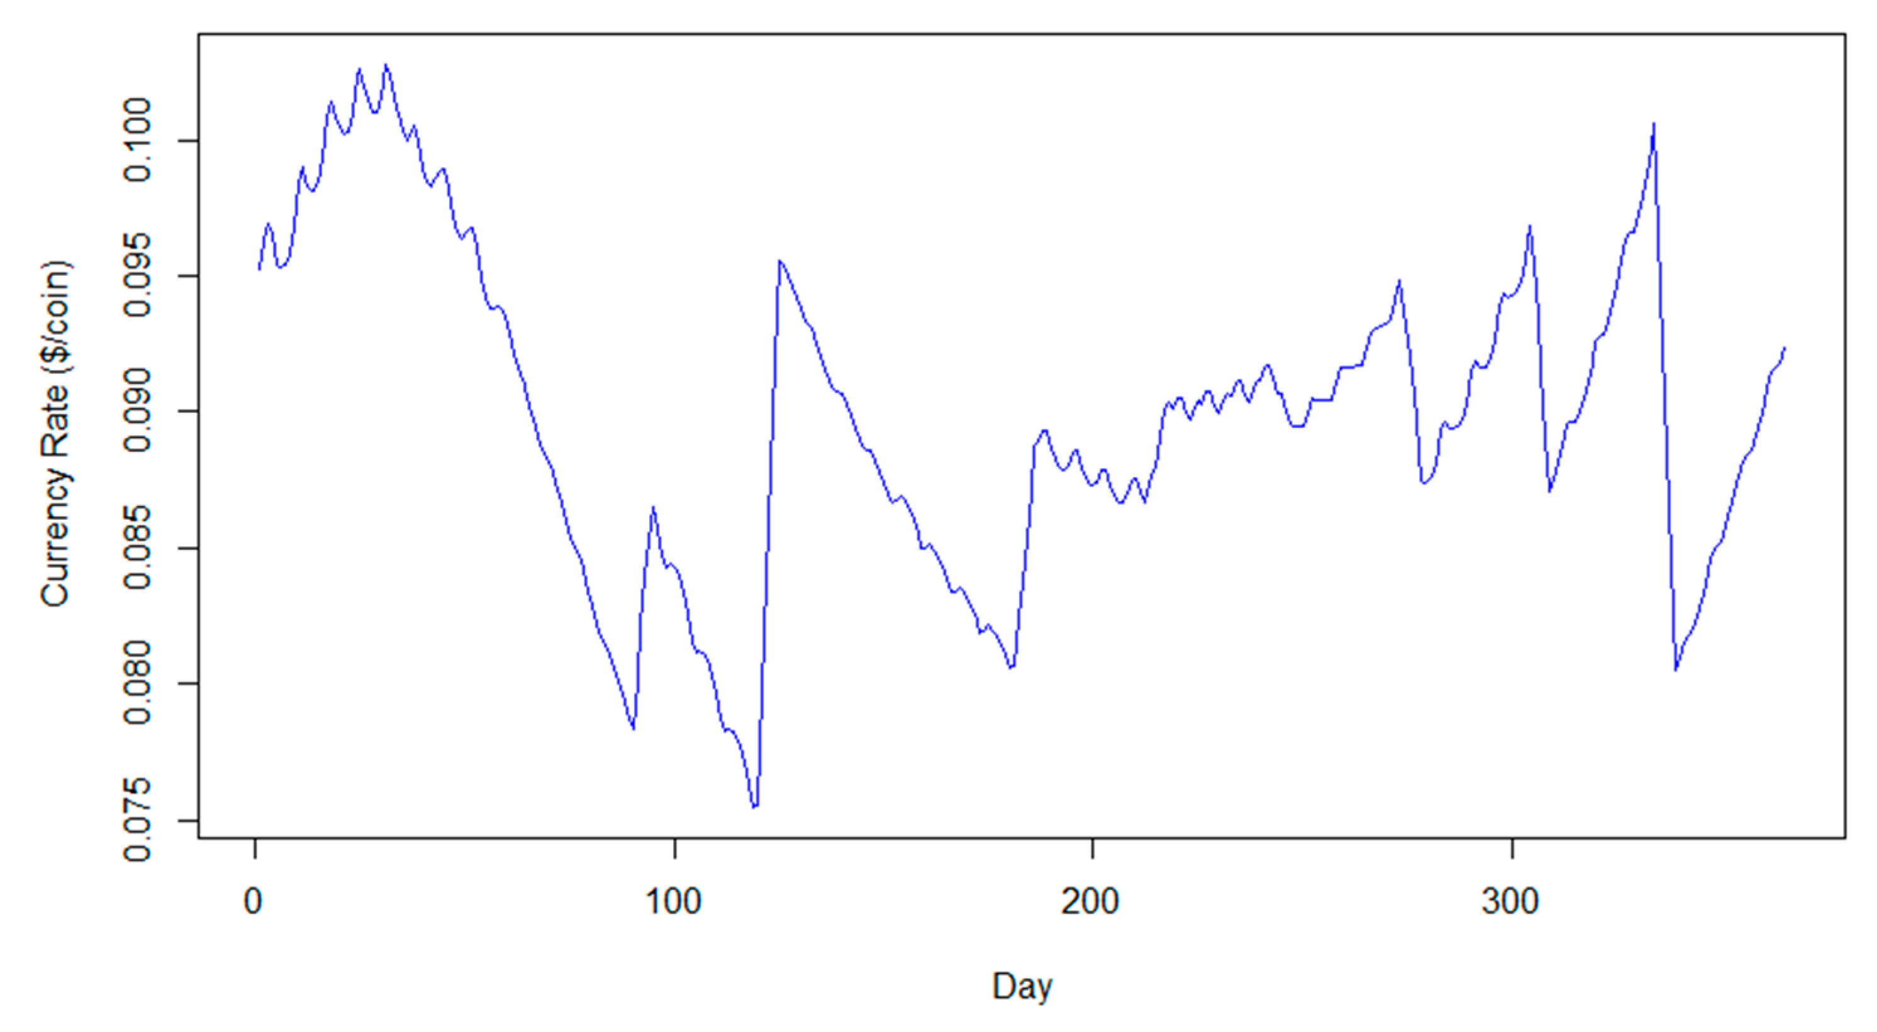
Energy analytics services [11/12]
Behavioural Energy Efficiency
  Digital energy currencies can play an important role in the new open energy market.
  Make people more aware of the dependence of energy consumption on their behavior.
The Network is funded by
From Intelligent Energy Management to Value Economy through a
Digital Energy Currency: Bahrain City Case Study, Sensors (Switzerland), 20(5), 1456, 2020

Slide 27

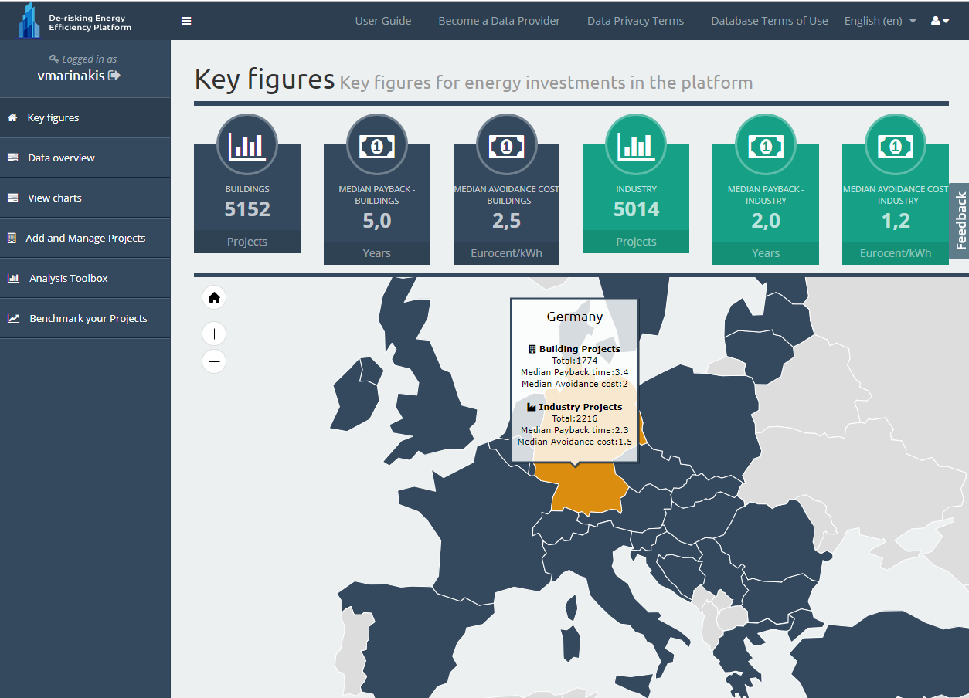
Energy analytics services [12/12]
Predictive analytics for energy efficiency investments de-risking
  Data analytics for improving the financeability of energy efficiency investments.
  Availability of comparable, anonymized historical data pooled from major market segments, structured along major project characteristics.
  Providing investors/financiers (e.g., commercial/green investment banks, institutional/insurance funds, etc.) and project developers (public/local authorities, energy providers, ESCOs, construction companies, etc.) with data and tools to identify sustainable investment pathways and decrease the investment risk.
The Network is funded by

Slide 28
Innovation Actions [1/3]
H2020 BD4NRG
Big Data for
Next Generation Energy​
BD4NRG
ENTSO-E, REST, IMEC
35 Partners​ & ​11 Countries ​
TNO, EGI
BE
RWTH, IDSA, FIWARE
NL
DE
Started:
01/01/2021
Duration:
36 Months
LV
LEIF
AU
UBIMET
SI
ELES, EKL, CS, BORZEN, UNILJ
LU
ED
RO
TS
REN, RDN, UNINOVA, ENERC
PT
TU
OEDAS
ATOS, CARTIF,
AJSCV, VEOLIA
ES
CY
CN
GR
NTUA, UNIWA, HOLISTIC
ENG, ENEL, ASM, ΕΜΟΤ, ELEX
IT
The Network is funded by
https://cordis.europa.eu/project/id/872613

Slide 29

Innovation Actions [2/3]
H2020 MATRYCS
The Network is funded by
https://matrycs.eu/

Slide 30


Innovation Actions [3/3]
ΑΤΟΜ
Innovative Personalised Apps to Motivate and Support Behavioural Energy Efficiency
Τhis project has received funding from the Hellenic Foundation for Research and Innovation (HFRI) and the General Secretariat for Research and Technology (GSRT), under grant agreement No [HFRI-FM17-2566].
The Network is funded by
http://atomcoin.gr/

Slide 31
The Network as a facilitator for successful synergies [1/2]
  Analyse how IoT can be mostly used by energy / facility managers, Energy Service Companies (ESCOs) and specialists, who take decisions based on the information they get.
  Investigate how citizens (energy end-users) can be included in a more efficient way in this process.
The Network is funded by

Slide 32
The Network as a facilitator for successful synergies [2/2]
Joint Research Studies
“From intelligent energy management to value economy through a digital energy currency: Bahrain city case study”, Sensors (Switzerland), 2020.
“Big data for energy management and energy-efficient buildings”, Energies, 2020.
“From big data to smart energy services: An application for intelligent energy management”, Future Generation Computer Systems, 2020.
“Optimal Design of an Islanded Microgrid with Load Shifting Mechanism Between Electrical and Thermal Energy Storage Systems”, IEEE Transactions on Power Systems, 2020.
“An Advanced IoT-based System for Intelligent Energy Management in Buildings”, Sensors, 2018.
“Digitizing energy savings in sustainable smart cities: Introducing a virtual energy-currency approach”, IEEE PerCom 2018 - International Conference on Pervasive Computing and Communications.
“Coordinated Frequency Control Strategy for an Islanded Microgrid with Demand Side Management Capability”, IEEE Transaction on Energy Conversion, 2018.
“Tracking the performance of photovoltaic systems: a tool for minimising the risk of malfunctions and deterioration”, IET Renewable Power Generation, 2018.
“Decision support for intelligent energy management in buildings using the thermal comfort model”, IJ of Computational Intelligence Systems, 2017
The Network is funded by

Slide 33
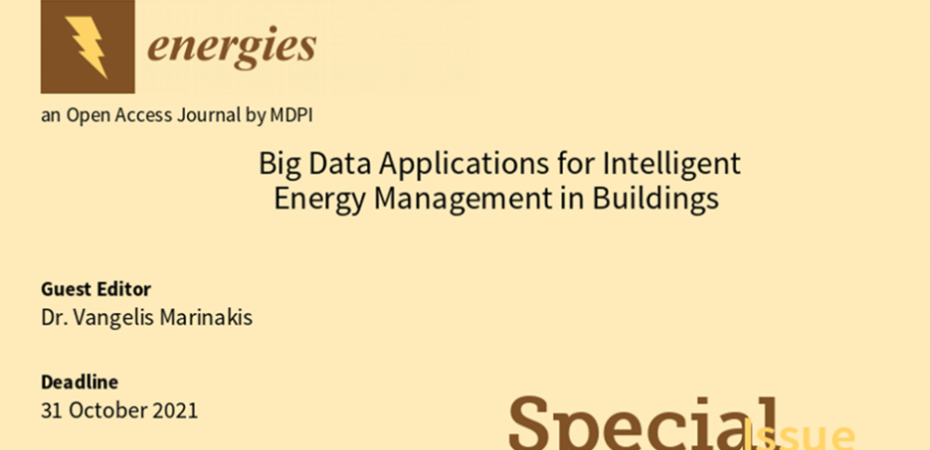
Special Issue
  Submit your paper!
The Network is funded by
https://www.mdpi.com/journal/energies/special_issues/Big_Data_Buildings

Slide 34
Thank you!
Dr. Vangelis Marinakis
Electrical & Computer Engineer, NTUA, EU GCC Clean Energy Technology Network Convener
Smart Energy Technologies and Digitalization
The Network is funded by
Wednesday – March 31 – 2021

